Slide 1


Fakes Detection
Kateryna Ruskykh
Kateryna Zabava
Rostyslav Zatserkovnyi

Slide 2
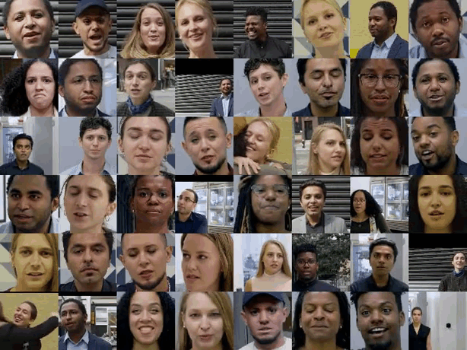
Problem statement
Deepfakes: fake videos produced by deep generated models that work with audio & video.
Harmful to people and society. Everyone can be a target of a humiliating manipulation.
Due to deepfakes news and even diplomacy can no longer be trusted!
source: https://ai.googleblog.com/2019/09/contributing-data-to-deepfake-detection.html

Slide 3
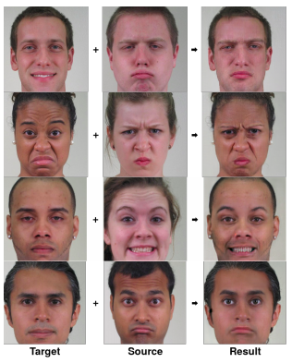
Prior research
Multiple existing deepfake methods:
DeepFake
Face2Face
FaceSwap
NeuralTextures
Learn what a source face looks like at different angles, then transpose its properties onto a target face
sources: https://github.com/deepfakes/faceswap, https://niessnerlab.org/papers/2019/8facetoface/thies2018face.pdf, https://github.com/MarekKowalski/FaceSwap/, https://arxiv.org/pdf/1904.12356.pdf

Slide 4
Prior research: FaceForensics++ Benchmarks
Method | Deepfakes | Face2Face | FaceSwap | NeuralTextures
Face Defence | 0.945 | 0.766 | 0.864 | 0.813
Xception | 0.964 | 0.869 | 0.903 | 0.807
Mesonet | 0.873 | 0.562 | 0.612 | 0.407
Steganalysis Features | 0.736 | 0.737 | 0.689 | 0.633
source: https://arxiv.org/pdf/1901.08971.pdf

Slide 5
Research objective
Detect fake images created by 4 image manipulation methods, using classical ML methods.

Slide 6


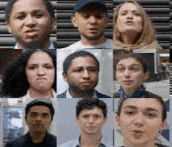
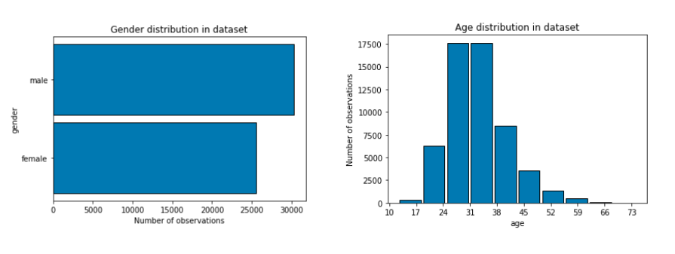



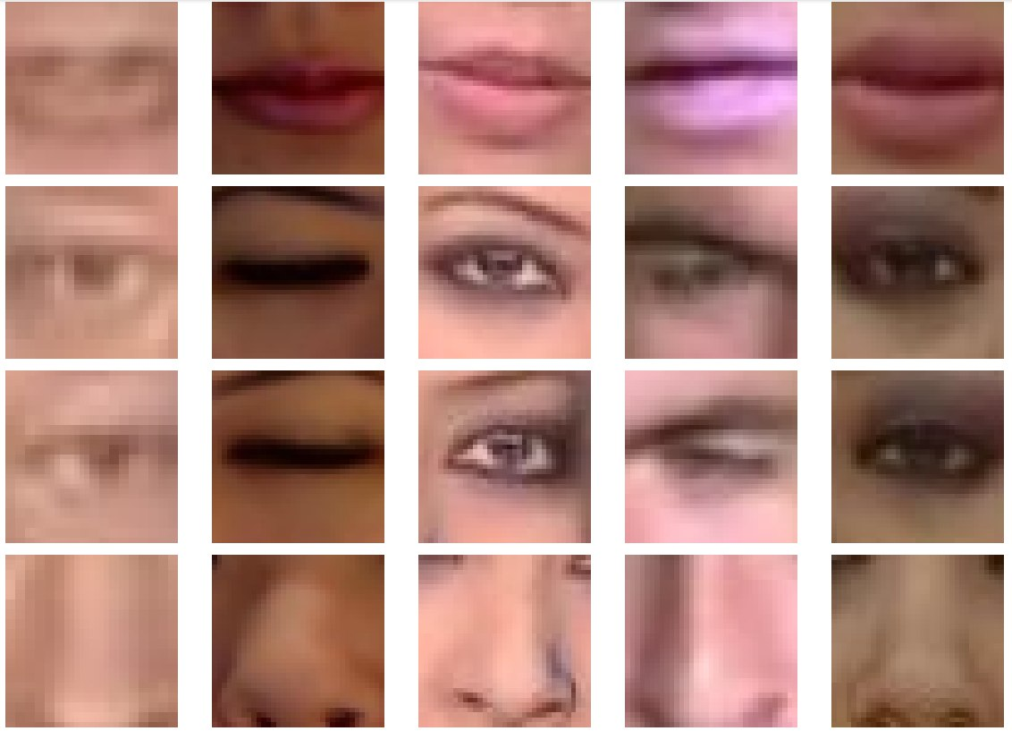
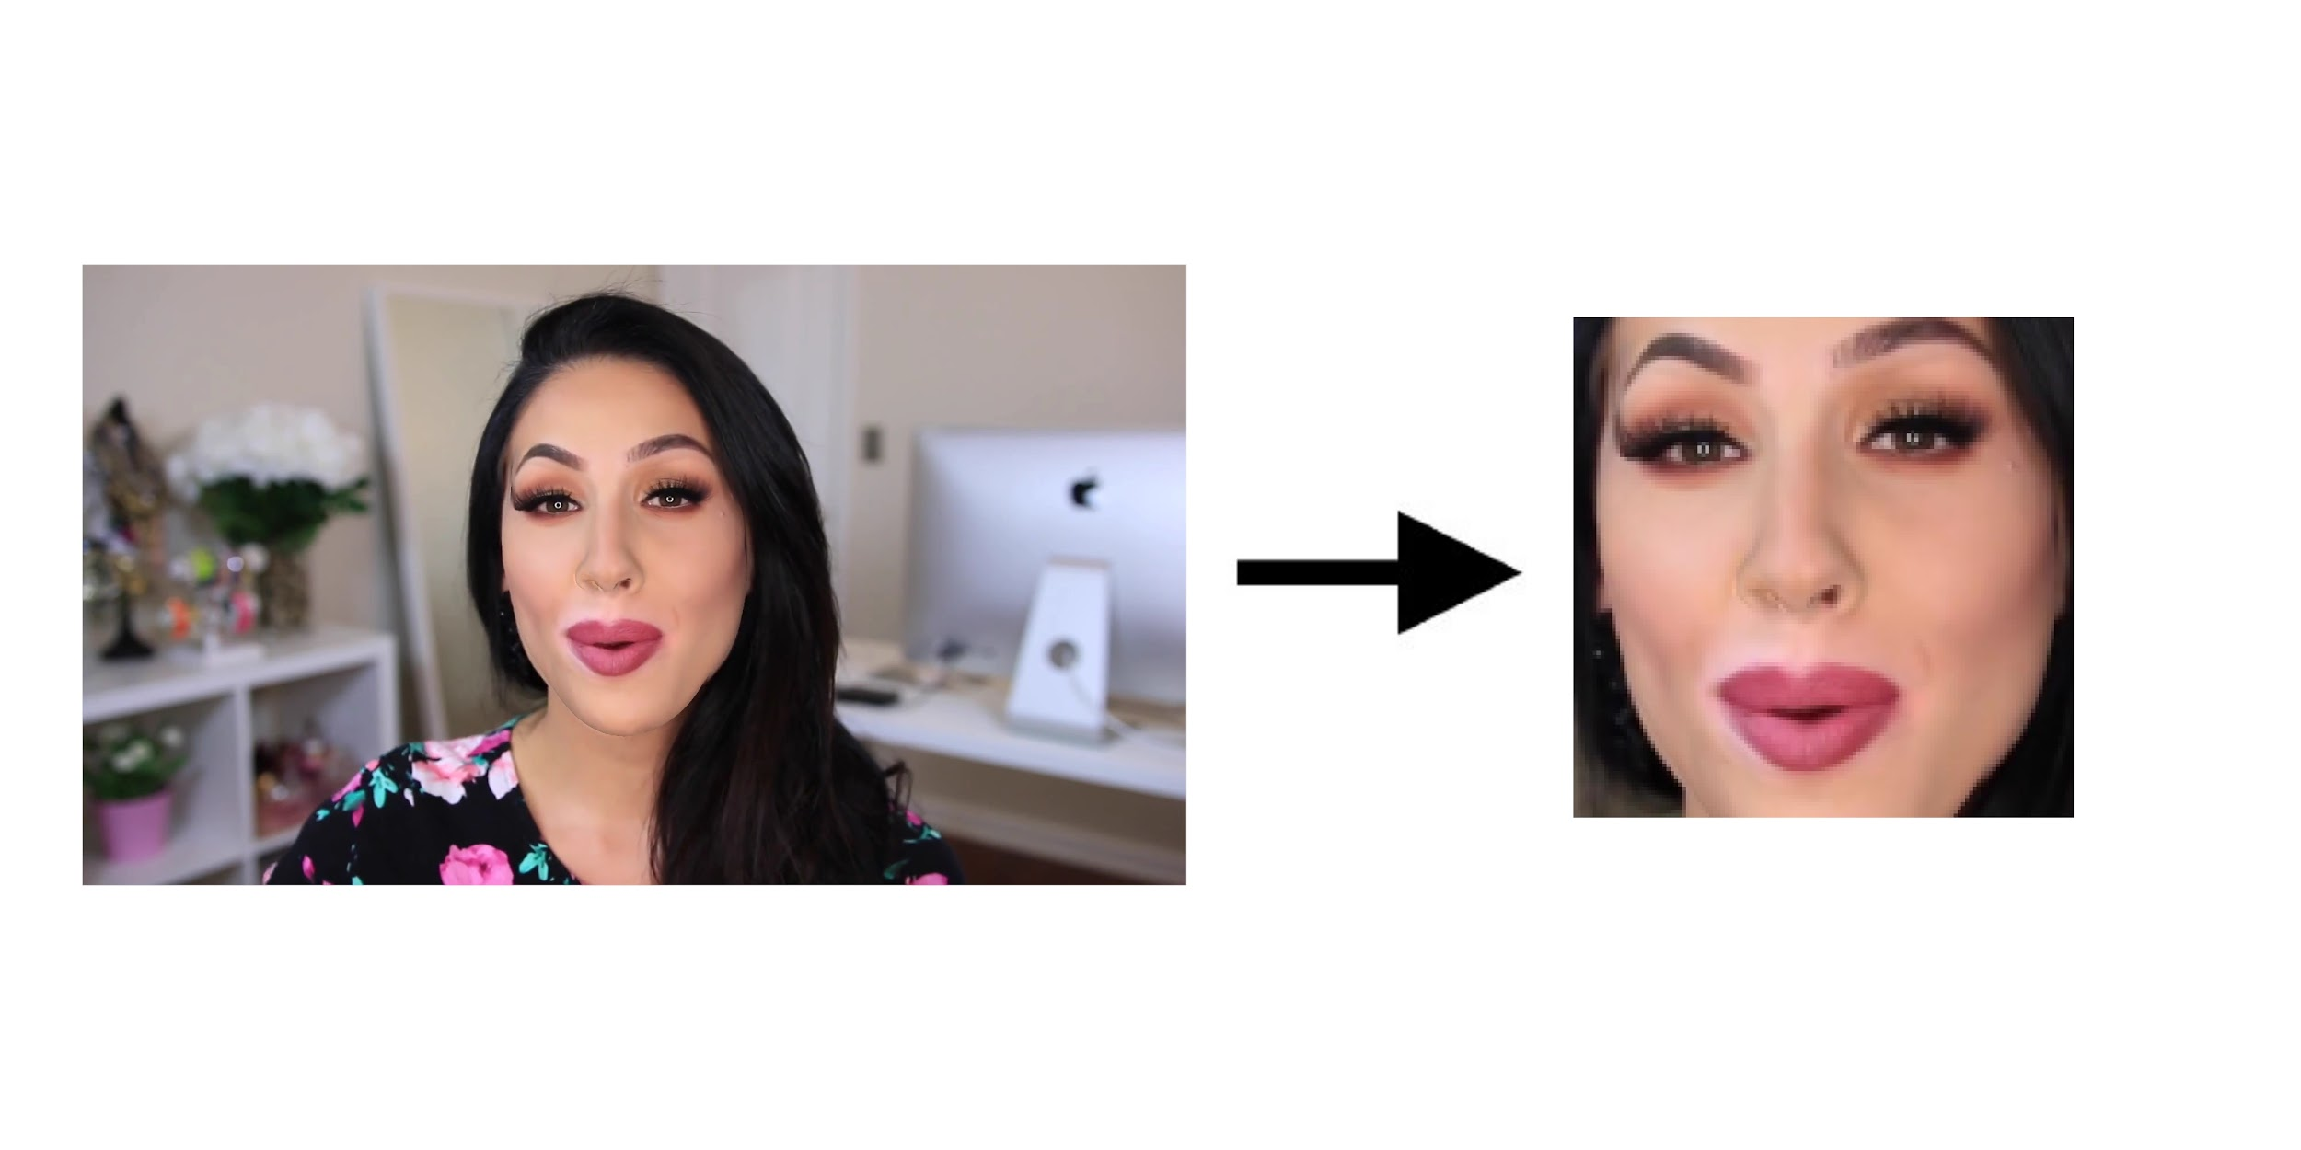

Workflow
6000 video
FaceForensics++
41000 faces
53000 images
Notes:
Geting access from FaceForensics++
Use download script to download videos 6000 videos
Use OpenCV to convert videos to images
Learn from the data: gender and age distributions
Use face_recognition library to extract faces from images
Extract features (left-eye, right-eye, nose, lips)
Standardize features and use them in the selected ML methods

Slide 7
Dataset collection and processing
Get dataset access from FaceForensics++
Use download script to download videos 6000 videos
Use OpenCV to convert videos to images
Learn from the data: gender and age distributions
Use face_recognition library to extract faces from images
Extract features (left-eye, right-eye, nose, lips)
Standardize features and use them in the selected ML methods

Slide 8
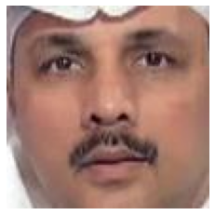
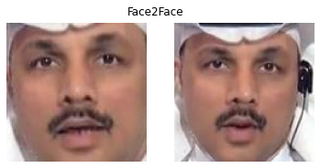
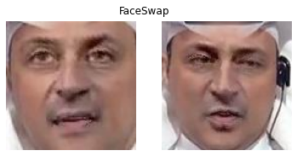
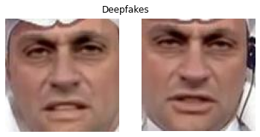

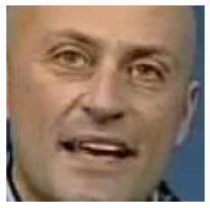
Dataset Faces
Real: Target
Real: Source

Slide 9
How many
 | Video | Images | Faces
Face2Face | 1000 | 10367 | 9207
FaceSwap | 1000 | 8014 | 6550
Deepfakes | 1000 | 9865 | 7760
NeuralTextures | 1000 | 7986 | 6641
Real YouTube | 1000 | 16615 | 7456
Real Actors | 1000 |  | 3731

Slide 10
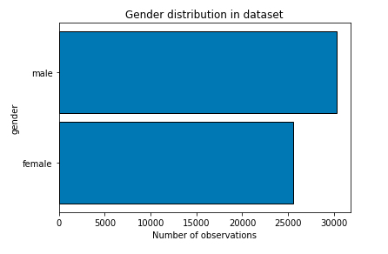
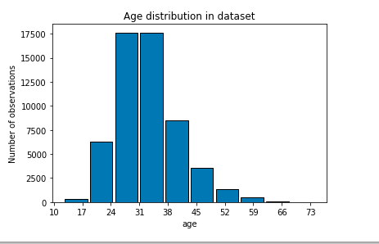
Dataset insights

Slide 11
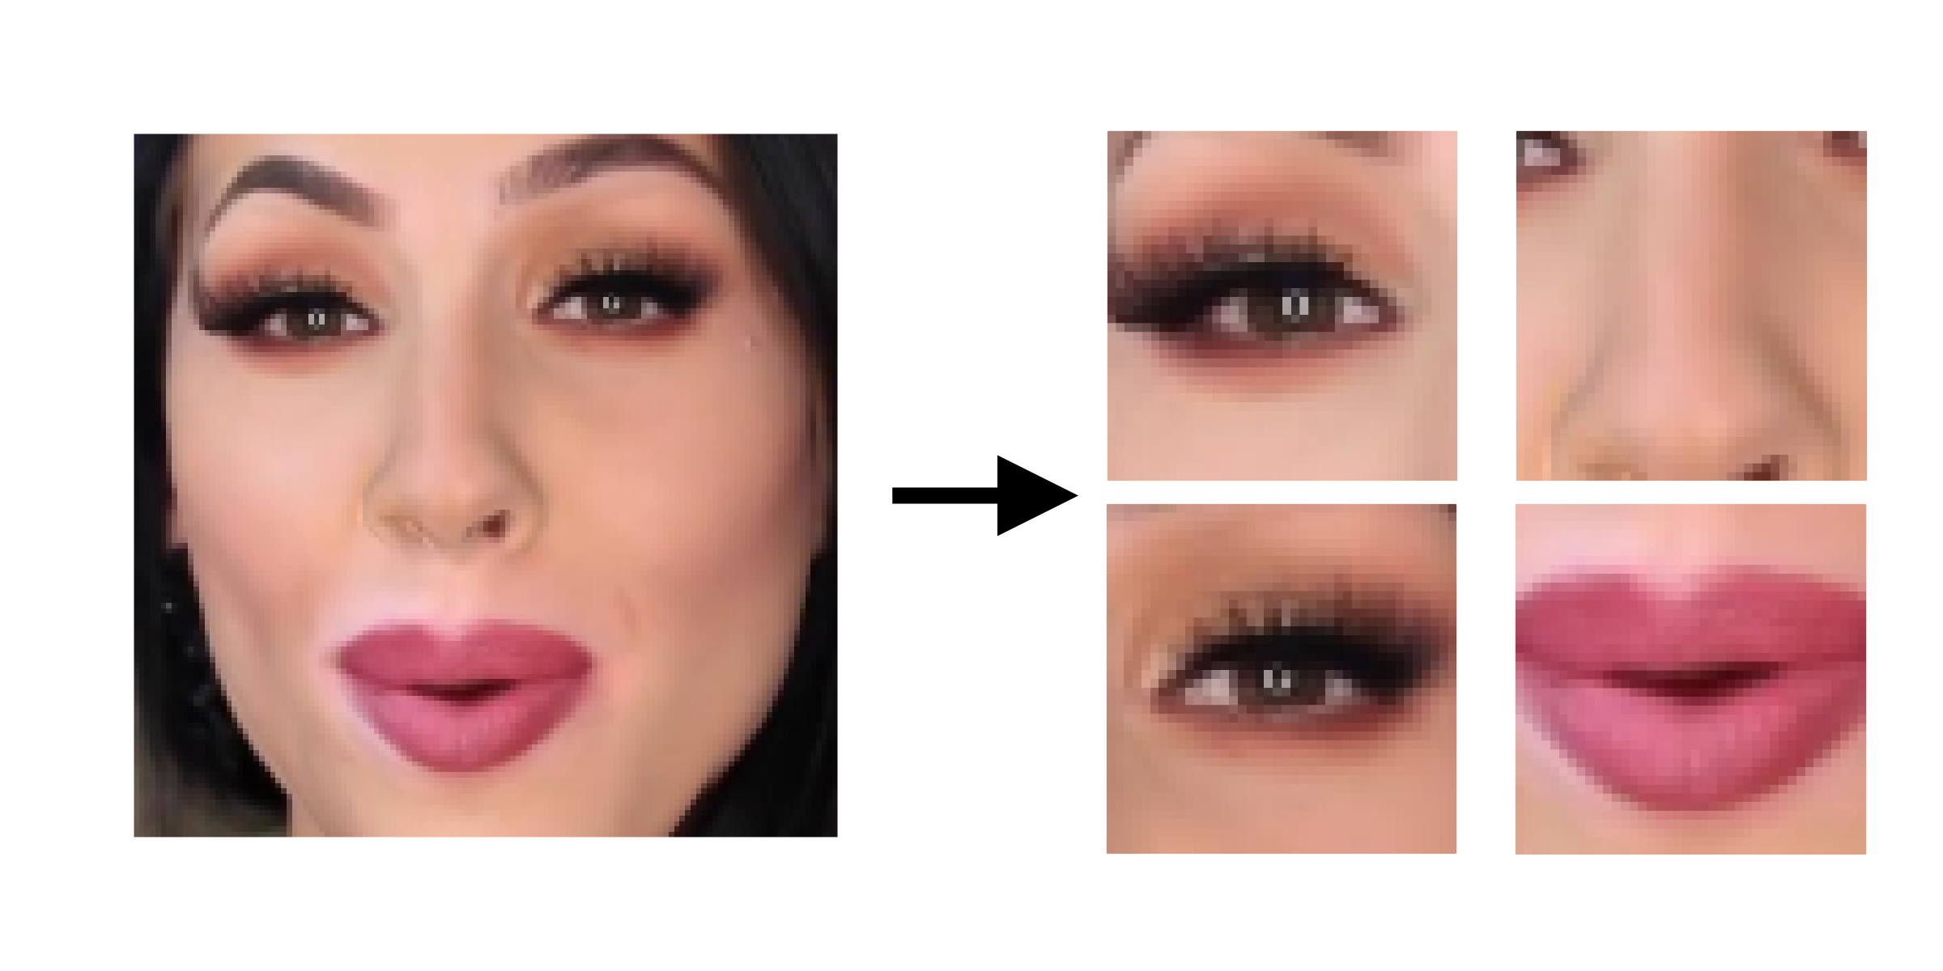
Feature Engineering
Using face_recognition API, a face is detected on an image
Four 40x40 facial landmarks are obtained from the face:
eye_left
eye_right
nose
lips
All landmarks are combined and converted into a single flat vector
source: https://github.com/ageitgey/face_recognition

Slide 12
Validation Strategy
Train-Validation-Test Split: 60%-20%-20%
All videos/images with the same target-person and source-person are in one split
Try to keep age / gender balance in the split
The number of fake = 1 and true = 0 classes is balanced in the models inputs

Slide 13
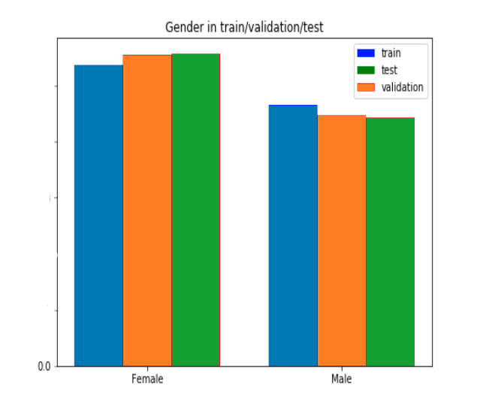
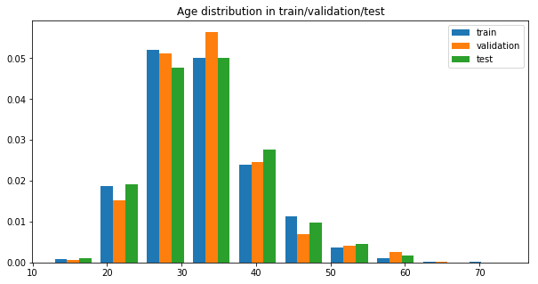
Train-Test-Validation: Balancing

Slide 14
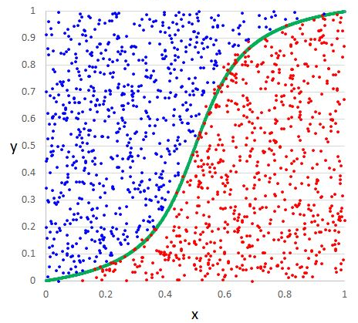

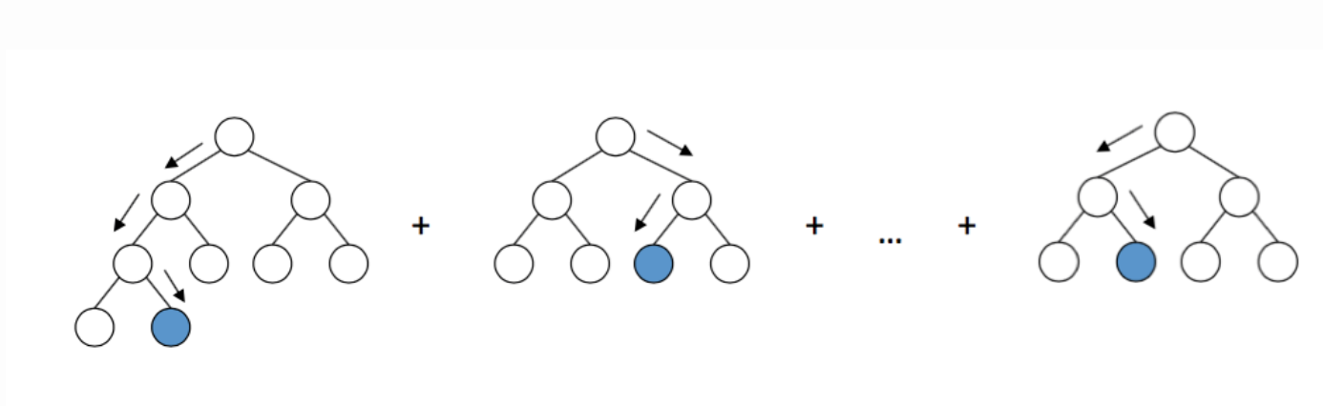
Methods
LightGBM
Logistic Regression
KNN

Slide 15
Results: Accuracy and F1
 | Face2Face | FaceSwap | Deepfakes | Neural Textures | Joint Model
Accuracy
LR | 0.70 | 0.62 | 0.70 | 0.59 | 0.67
LGBM | 0.70 | 0.78 | 0.88 | 0.57 | 0.72
KNN | 0.58 | 0.58 | 0.64 | 0.58 | 0.63
F1
LR | 0.71 | 0.63 | 0.70 | 0.59 | 0.67
LGBM | 0.68 | 0.78 | 0.88 | 0.56 | 0.72
KNN | 0.55 | 0.58 | 0.63 | 0.51 | 0.64

Slide 16
Results: Recall and F1
 | Face2Face | FaceSwap | Deepfakes | Neural Textures | ALL
Recall
LR | 0.71 | 0.63 | 0.70 | 0.59 | 0.67
LGBM | 0.68 | 0.78 | 0.88 | 0.56 | 0.72
KNN | 0.56 | 0.58 | 0.64 | 0.5 | 0.63
F1
LR | 0.71 | 0.63 | 0.70 | 0.59 | 0.67
LGBM | 0.68 | 0.78 | 0.88 | 0.56 | 0.72
KNN | 0.55 | 0.58 | 0.63 | 0.51 | 0.64

Slide 17
Results: AUC
 | Face2Face | FaceSwap | Deepfakes | Neural Textures | ALL
AUC
LR | 0.79 | 0.70 | 0.78 | 0.64 | 0.73
LGBM | 0.77 | 0.89 | 0.96 | 0.60 | 0.80
KNN

Slide 18
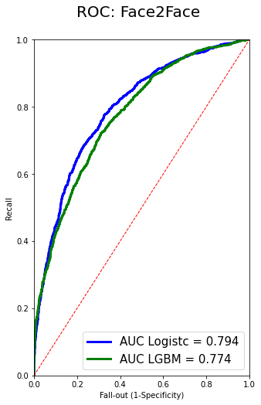
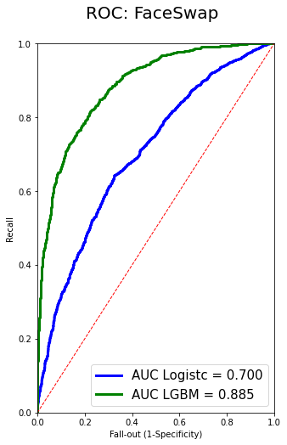
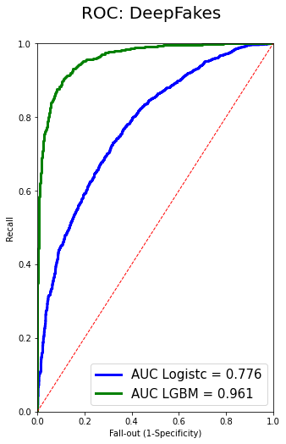
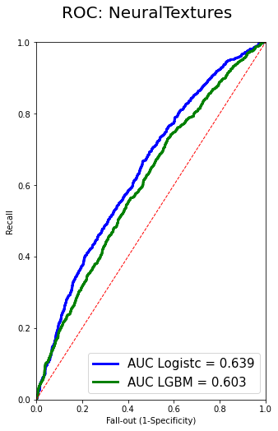
Results: AUC for separate models

Slide 19
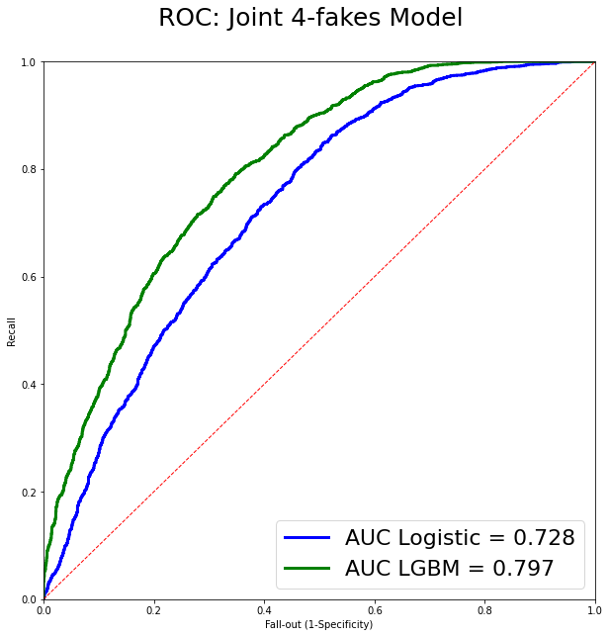
Results: AUC for the joint model

Slide 20
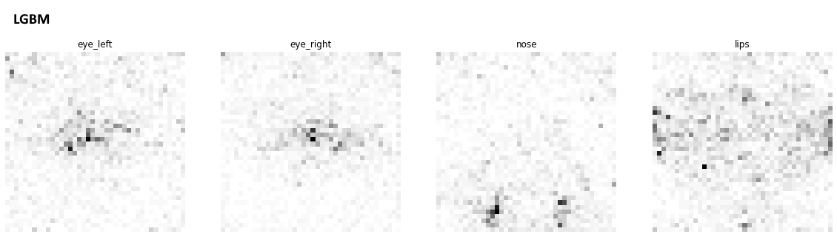
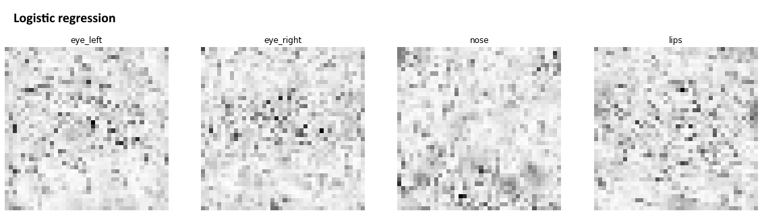
Results: Feature importance

Slide 21
Results: Attempt of Regularization
Logistic Regression
Face2Face model
L1 with lambda = [0.001, 0.003, 0.006, 0.1, 0.3, 0.6, 0.8, 1, 5, 10, 100] on the validation set
Result: lambda = 0.003 increased validation accuracy from 0.7 to 0.74, while the test set accuracy increased from 0.7 to 0.72

Slide 22
Conclusion:
Classic ML Methods can work well on image classification tasks
Overfitting can be a big problem: should invest time in it.

Slide 23
Thank you!

